Slide 1
Bankruptcy Bets
Helping Banks Find Better Partners
Chloe B. Platek, Dovid Zev Rosenbaum, Jonkheer David G. Graafland, Leonardo G. Luchetti,
Owakhela Kankhwende, Sruthi Mudunuri
Notes:
Good morning, we’re team 4 and today we’re going to speak a little about how we’re trying to help banks find better partners

Slide 2
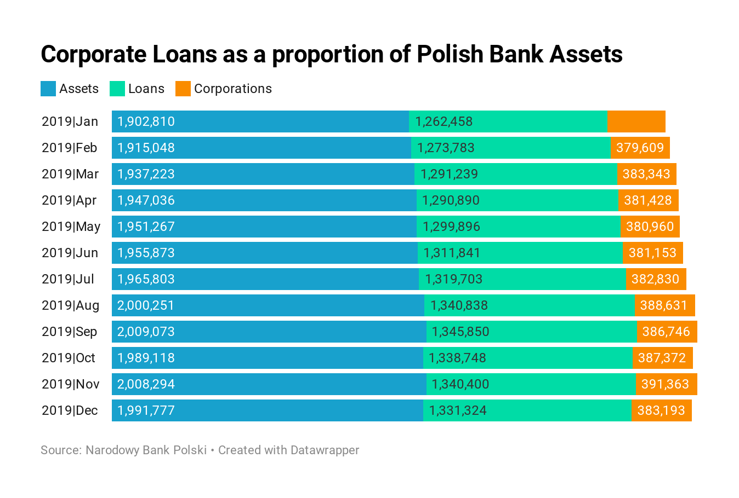
Problem Statement
On average in 2019 corporate loans made up 29.2% of bank loans in Poland and 19.5% of Polish bank assets in the year.
Polish Bank, PKO, is looking for a predictive modelling based solution to mitigate potential client risk of default, protect loan payback and interest profits. This method would assist PKO in making the best informed decision on who to lend to by predicting bankruptcies amongst their 10,000 clients.
Notes:
The industry boasts a robust lending system to corporate debtors and is stringent on healthy returns. On average, in 2019, corporate loans made up close to 30% of bank loans in Poland and almost 20% of Polish bank assets. With the advent of modern data analysis techniques, PKO wanted us to develop a way to predict their clients' potential financial distress. Corporate bankruptcy can put around 383,000 zloty or $100,000 at risk for PKO so minimizing risk is important to their bottom line.
383,000 Poland złoty equals
104,076.31 United States Dollar

Slide 3
Planning the Prediction Model
Data: 10,000 rows of 64 financial ratios of Polish corporations, including the class-dependent variable that details whether the corporation went bankrupt (1) or not (0)
Insights: Probability of a corporation going bankrupt and probable profit amongst the most financially viable
Decision: What corporations to supply credit to
Advantage: Minimizing the risk of default of loans underwritten by PKO, maximize interest income

Slide 4
Data Acquisition & Pre
processing
The predictor data is numerical, standardized and does not contain missing values.
Before having eliminated any attributes, for probability as per the formula n = 6 x m x (u + 1) we required at minimum 6 x 2 x (64 + 1) = 780. As we had 10,000, we opted to assess observations that must be eliminated in data exploration and preprocessing.
No need for Categorical variable coding amongst predictors as they are all numerical variables. Only done on class variable.
Utilized two methods to cull down the large dataset
Mean Analysis
Principal Component Analysis
Notes:
The data was collected from Emerging Markets Information Service (EMIS), which is a database containing information on emerging markets around the world. The data covers companies from 2000 - 2013

Slide 5
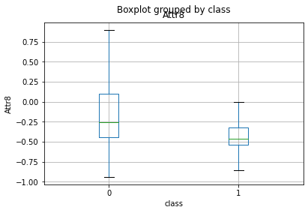
Mean Analysis
Split Bankrupt and Non-Bankrupt set
Ranked difference means in the two data sets
Attributes paired if correlation higher than +0.8
Attribute with lower importance dropped
38 attributes left
Notes:
We have a large amount of variables so we’re looking to cull that data. So we used mean analysis. So first we take the mean of all the attributes, then we took the correlation of those attributes. The ones that have a correlation of .8 or more will drop.the lower one. Reduces to 38

Slide 6
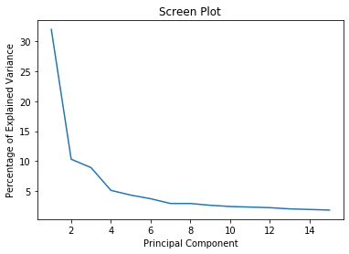
Principal Component Analysis
Reduce data set to it down to its most essential part
Initial drilling down to top 15 attributes
The chart below details our final results
Notes:
We added PCA to add another comparison, we drilled down to 15 15 attributes and then drilled down further to the top 7.

Slide 7
7
Number of top principal components found

Slide 8
Over
Sampling
Large data set containing 10,000 observations
Small percentage of clients that actually go bankrupt, less than 3% - class imbalance
Oversampling would benefit certain models and not others
Notes:
It’s very hard for our model to learn what exact attributes make a change when the dependent variable is so small.

Slide 9
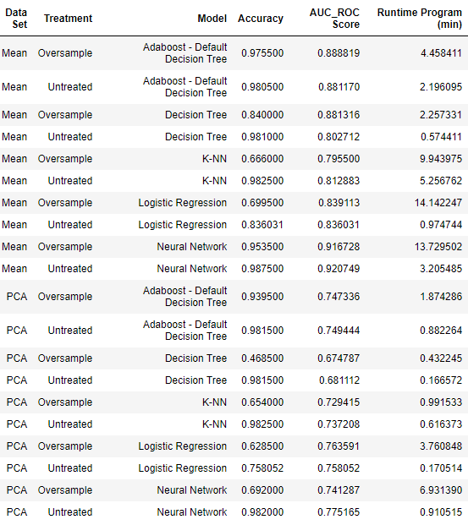
Model Execution
Notes:
On one dataset we did oversample the data and on the other we did no such treatment.
[Leo] These two attributes are going to be the most important to check because we need AUC_ROC of course, but run time needs to be considered when deploying a model.
-ran each model with both untreated/oversampled datasets and mean/PCA analyses, results are as follows:
-main performance indicators: AUC_ROC & Runtime Program

Slide 10
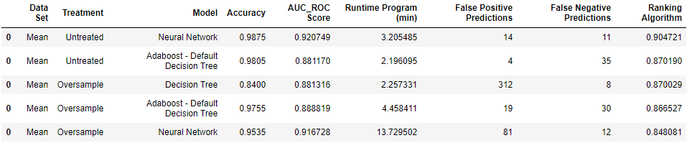
Model Selection - Top 5 Performers
Notes:
We created a ranking algorithm to rank the top models. [Talk about algorithm]. We conducted a confusion matrix to understand where the false positive and false negatives. Neural network has the fewest false negatives
-to account for both variables: Ranking Algorithm that adjusts for a predetermined weight
-concluded 5 models based on such ranking

Slide 11
Model Selection Top 5 Performers
Neural Networks Model (untreated database with mean analysis)
Best AUC_ROC & Efficient run time
Low false negative prediction
Notes:
First recommendation is for untreated neural network since it performs the best. It has a very low false negative prediction which is important for banks when determining who is going to go bankrupt.
Plan B would be decision tree on oversampled data because it has a very low false negative prediction total.
-executed a confusion matrix to get more in depth analysis of the predictors
-False Positive: companies the model predicts will go bankrupt, but actually did not
-False Negative: companies the model predicts will not go bankrupt, but actually do → EMPHASIZE (try to minimize - we don’t want model to support such an investment)
-with specific knowledge on the return for each investment, we would be able to give more accurate predictions
-so far: Neural Network (based on performance and low false negative) or Decision Tree Model (based on a conservative investment approach - minimizes risk)

Slide 12
Model Selection Top 5 Performers
Neural Networks Model (untreated database with mean analysis)
Best AUC_ROC & Efficient run time
Low false negative prediction
Decision Tree Model (oversampled database with mean analysis)
3rd AUC_ROC Score
Lower Runtime
Minimizes False Negative Predictions
Notes:
First recommendation is for untreated neural network since it performs the best. It has a very low false negative prediction which is important for banks when determining who is going to go bankrupt.
Plan B would be decision tree on oversampled data because it has a very low false negative prediction total.
-executed a confusion matrix to get more in depth analysis of the predictors
-False Positive: companies the model predicts will go bankrupt, but actually did not
-False Negative: companies the model predicts will not go bankrupt, but actually do → EMPHASIZE (try to minimize - we don’t want model to support such an investment)
-with specific knowledge on the return for each investment, we would be able to give more accurate predictions
-so far: Neural Network (based on performance and low false negative) or Decision Tree Model (based on a conservative investment approach - minimizes risk)

Slide 13
Plans For Future Research
Breaking down the data further for possibly more comprehensive analysis
Expand our database to include countrywide macroeconomic data.
Fold in database of global economic metrics to capture multinational entities and global effects on predicting bankruptcy
Notes:
The title of our presentation is helping banks find better partners. The beauty of this approach to predicting bankruptcy is its universality. By bringing in more global data, more macroeconomic data we will hopefully be able to predict bankruptcy with higher accuracy during tough times.

